Slide 1
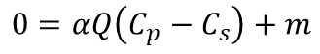
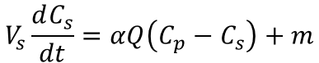
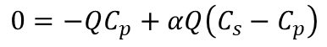
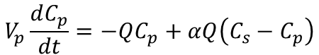
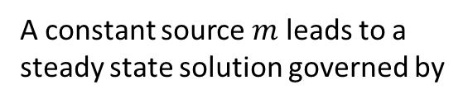
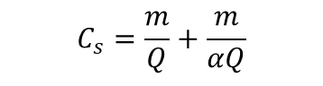

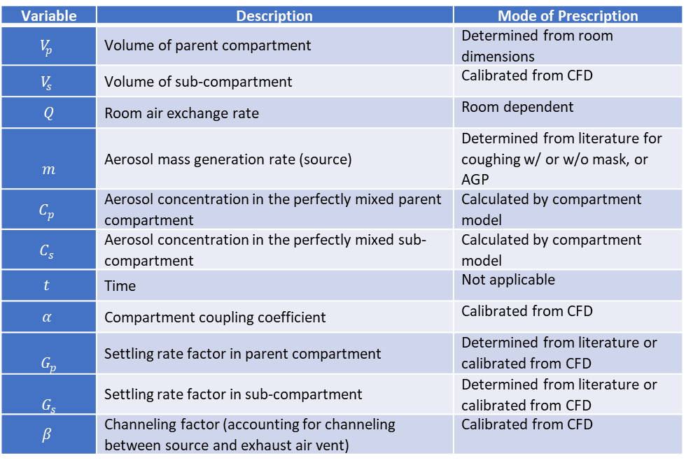
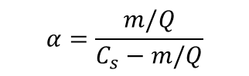
Variable | Description | Mode of Prescription
$$V_{p}$$ | Volume of parent compartment | Determined from room dimensions
$$V_{s}$$ | Volume of sub-compartment | Calibrated from CFD
$$Q$$ | Room air exchange rate | Room dependent
$$m$$ | Aerosol mass generation rate (source) | Determined from literature for coughing w/ or w/o mask, or AGP
$$C_{p}$$ | Aerosol concentration in the perfectly mixed parent compartment | Calculated by compartment model
$$C_{s}$$ | Aerosol concentration in the perfectly mixed sub-compartment | Calculated by compartment model
$$t$$ | Time | Not applicable
$$α$$ | Compartment coupling coefficient | Calibrated from CFD
$$G_{p}$$ | Settling rate factor in parent compartment | Determined from literature or calibrated from CFD
$$G_{s}$$ | Settling rate factor in sub-compartment | Determined from literature or calibrated from CFD
$$β$$ | Channeling factor (accounting for channeling between source and exhaust air vent) | Calibrated from CFD
Two-compartment model without channeling
Neglecting sinks (settling) and channeling
A constant source $m$ leads to a
steady state solution governed by
$$V_{p}\frac{dC_{p}}{dt}=−QC_{p}+αQ\left(C_{s}−C_{p}\right)$$
$$C_{p}=\frac{m}{Q}$$
$$0=−QC_{p}+αQ\left(C_{s}−C_{p}\right)$$
$$α=\frac{m/Q}{C_{s}−m/Q}$$
adding
& solving
$$V_{s}\frac{dC_{s}}{dt}=αQ\left(C_{p}−C_{s}\right)+m$$
$$C_{s}=\frac{m}{Q}+\frac{m}{αQ}$$
$$0=αQ\left(C_{p}−C_{s}\right)+m$$

Slide 2
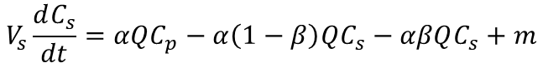
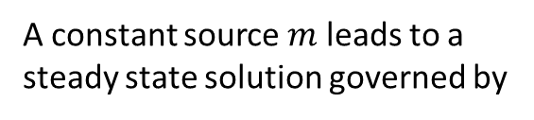
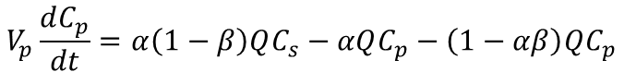
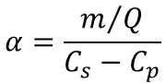
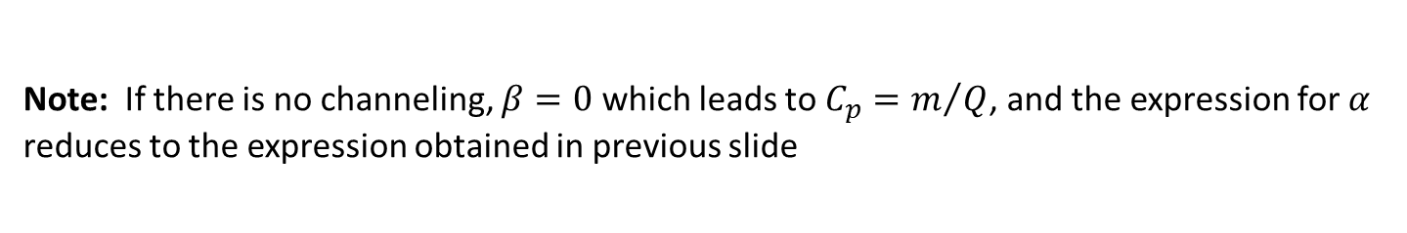
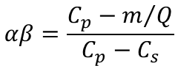
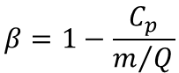
Two-compartment model with channeling
Neglecting sinks (settling)
$$V_{p}\frac{dC_{p}}{dt}=α\left(1−β\right)QC_{s}−αQC_{p}−\left(1−αβ\right)QC_{p}$$
$$V_{s}\frac{dC_{s}}{dt}=αQC_{p}−α\left(1−β\right)QC_{s}−αβQC_{s}+m$$
A constant source $m$ leads to a
steady state solution governed by
$$0=\left(α−αβ\right)QC_{s}−αQC_{p}−\left(1−αβ\right)QC_{p}$$
(1)
$$α=\frac{m/Q}{C_{s}−C_{p}}$$
adding
& solving
inserting into
(1) & solving
(2)
$$αβ=\frac{C_{p}−m/Q}{C_{p}−C_{s}}$$
$$0=αQC_{p}−\left(α−αβ\right)QC_{s}−αβQC_{s}+m$$
$$β=1−\frac{C_{p}}{m/Q}$$
Note: If there is no channeling, $β=0$ which leads to $C_{p}=m/Q$, and the expression for $α$
reduces to the expression obtained in previous slide

Slide 3
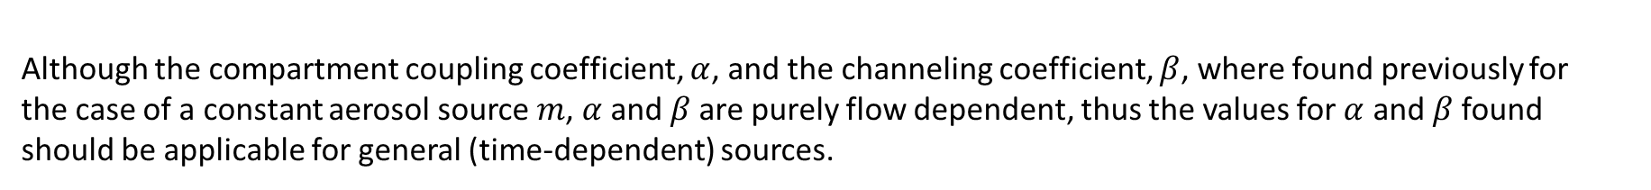
Although the compartment coupling coefficient, $α$, and the channeling coefficient, $β$, where found previously for
the case of a constant aerosol source $m$, $α$ and $β$are purely flow dependent, thus the values for $α$ and $β$found
should be applicable for general (time-dependent) sources.
Next we solve the compartment model ODEs numerically

Slide 4
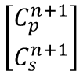
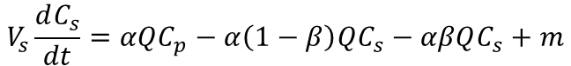
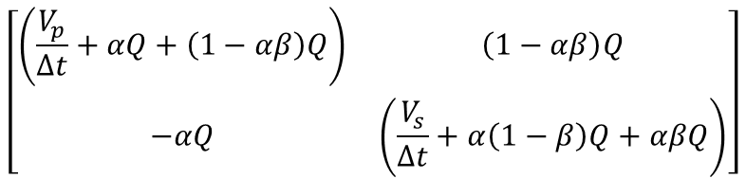
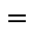
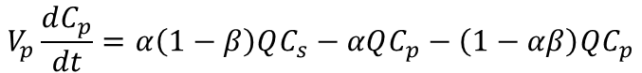
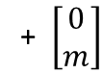
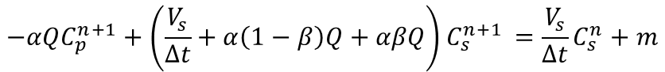
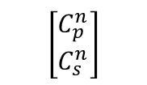
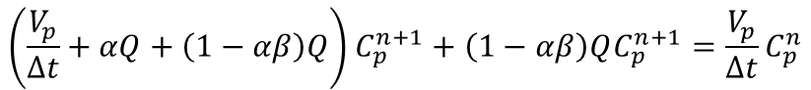
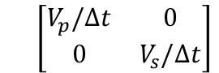
Neglecting sinks (settling)
$$\frac{V_{p}}{Δt}C_{p}^{n+1}−α\left(1−β\right)QC_{s}^{n+1}+αQC_{p}^{n+1}+\left(1−αβ\right)QC_{p}^{n+1}=\frac{V_{p}}{Δt}C_{p}^{n}$$
$$V_{p}\frac{dC_{p}}{dt}=α\left(1−β\right)QC_{s}−αQC_{p}−\left(1−αβ\right)QC_{p}$$
$$\frac{V_{s}}{Δt}C_{s}^{n+1}−αQC_{p}^{n+1}+α\left(1−β\right)QC_{s}^{n+1}+αβQC_{s}^{n+1}=\frac{V_{s}}{Δt}C_{s}^{n}+m$$
$$V_{s}\frac{dC_{s}}{dt}=αQC_{p}−α\left(1−β\right)QC_{s}−αβQC_{s}+m$$
$$\left(\frac{V_{p}}{Δt}+αQ+\left(1−αβ\right)Q\right)C_{p}^{n+1}+\left(1−αβ\right)QC_{p}^{n+1}=\frac{V_{p}}{Δt}C_{p}^{n}$$
Discretizing with implicit Euler
$$V_{p}\frac{(C_{p}^{n+1}−C_{p}^{n})}{Δt}=α\left(1−β\right)QC_{s}^{n+1}−αQC_{p}^{n+1}−\left(1−αβ\right)QC_{p}^{n+1}$$
$$−αQC_{p}^{n+1}+\left(\frac{V_{s}}{Δt}+α\left(1−β\right)Q+αβQ\right)C_{s}^{n+1 }=\frac{V_{s}}{Δt}C_{s}^{n}+m$$
$$V_{s}\frac{(C_{s}^{n+1}−C_{s}^{n})}{Δt}=αQC_{p}^{n+1}−α\left(1−β\right)QC_{s}^{n+1}−αβQC_{s}^{n+1}+m$$
$$\left[\begin{matrix}\left(\frac{V_{p}}{Δt}+αQ+\left(1−αβ\right)Q\right) & \left(1−αβ\right)Q \\ −αQ & \left(\frac{V_{s}}{Δt}+α\left(1−β\right)Q+αβQ\right)\end{matrix}\right]$$
$$\left[\begin{matrix}C_{p}^{n+1} \\ C_{s}^{n+1}\end{matrix}\right]$$
$$\frac{V_{p}}{Δt}C_{p}^{n+1}−\frac{V_{p}}{Δt}C_{p}^{n}=α\left(1−β\right)QC_{s}^{n+1}−αQC_{p}^{n+1}−\left(1−αβ\right)QC_{p}^{n+1}$$
$$\left[\begin{matrix}V_{p}/Δt & 0 \\ 0 & V_{s}/Δt\end{matrix}\right]$$
$$\left[\begin{matrix}C_{p}^{n} \\ C_{s}^{n}\end{matrix}\right]$$
$$\frac{V_{s}}{Δt}C_{s}^{n+1}−\frac{V_{s}}{Δt}C_{s}^{n}=αQC_{p}^{n+1}−α\left(1−β\right)QC_{s}^{n+1}−αβQC_{s}^{n+1}+m$$
$$=$$
+ $\left[\begin{matrix}0 \\ m\end{matrix}\right]$

Slide 5
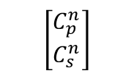
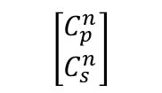
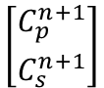
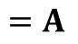
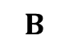
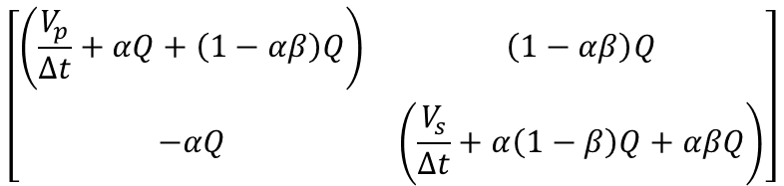
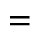
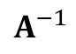
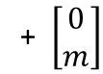
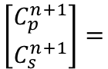
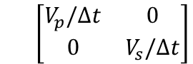
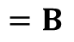
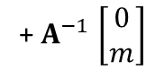
$$\left[\begin{matrix}\left(\frac{V_{p}}{Δt}+αQ+\left(1−αβ\right)Q\right) & \left(1−αβ\right)Q \\ −αQ & \left(\frac{V_{s}}{Δt}+α\left(1−β\right)Q+αβQ\right)\end{matrix}\right]$$
$$\left[\begin{matrix}C_{p}^{n+1} \\ C_{s}^{n+1}\end{matrix}\right]$$
$$\left[\begin{matrix}V_{p}/Δt & 0 \\ 0 & V_{s}/Δt\end{matrix}\right]$$
$$\left[\begin{matrix}C_{p}^{n} \\ C_{s}^{n}\end{matrix}\right]$$
$$=$$
+ $\left[\begin{matrix}0 \\ m\end{matrix}\right]$
$$=B$$
$$=A$$
$$\left[\begin{matrix}C_{p}^{n+1} \\ C_{s}^{n+1}\end{matrix}\right]=$$
$$A^{−1}$$
$$\left[\begin{matrix}C_{p}^{n} \\ C_{s}^{n}\end{matrix}\right]$$
+ $A^{−1}$ $\left[\begin{matrix}0 \\ m\end{matrix}\right]$
$$B$$

Slide 6






flow in
$$m_{2}$$
flow in
$$m_{5}$$
flow out
$$m_{1}$$
$$m_{3}$$
$$m_{4}$$
$$m_{6}$$

